Slide 1

Free School Classified Ads

Slide 2
WHAT IT IS
Acadym organise the school information and make it reachable and valuable to parents/users.
We help education institute to promote their school on internet.
Acadym fundamental objective is to provide a leading, online classified advertising solution that targets schools in India.

Slide 3
WHAT PROBLEM IT SOLVES
Acadym is free to use. Free to contact school by mail and phone.
Without visiting school location, user can shortlist the schools as per their requirement.
Contact school via email or phone.
Compare the schools.
No repository of school where they can search the school as per their criteria.
Communicable on social media.
Add and view reviews.

Slide 4
WHO IT SERVES
> 5 MM Schools
Preschool
Boarding School
School
Engineering College
ETC.
Medical College

Slide 5
CONNECT WITH US
Advertisement
Email
Pay Per Click
Blog
Forum
Campaign
SEO
Content Marketing
Social Media
Facebook
Twitter
Google+
LinkedIn
Pinterest
Tumblr

Slide 6
TEAM/WHY YOU
We are having more than 14 years of experience in IT industry. We are well verse with latest technologies and best practices used in industry.
We have done lot of research for making idea into reality.
Current team comprise of UI developer and couple of programmer. We will be hiring marketing, technology and support to bring expertise in our team.

Slide 7
OTHER KEY POINTS
Acadym is a free classified and dedicated school ad website for Preschool, School, Boarding School and everything else in Educational Institute. Acadym will facilitate school to post their listing for free. Users will search the schools as per their criteria and shortlist it without visiting them. Acadym is 100% free to use. Free to post an ad, free to browse listings, free to contact school.
We devote a great deal of time and effort in monitoring and filtering the content posted to the website, so you can be confident that you'll find only quality, relevant listings and reviews
We have around 30000 schools in our database.

Slide 8
OTHER KEY POINTS - USP
Users
100% Free to use
User can get a glance of school in single click
Search the schools as per their criteria's
Compare School
Local search engine
No need to go to each school
Communicable on social media

Slide 9
3 WAYS TO SEARCH
Option 1
Search Text
Click Go button
Select Category
Select City
Option 2
Click Category

Slide 10
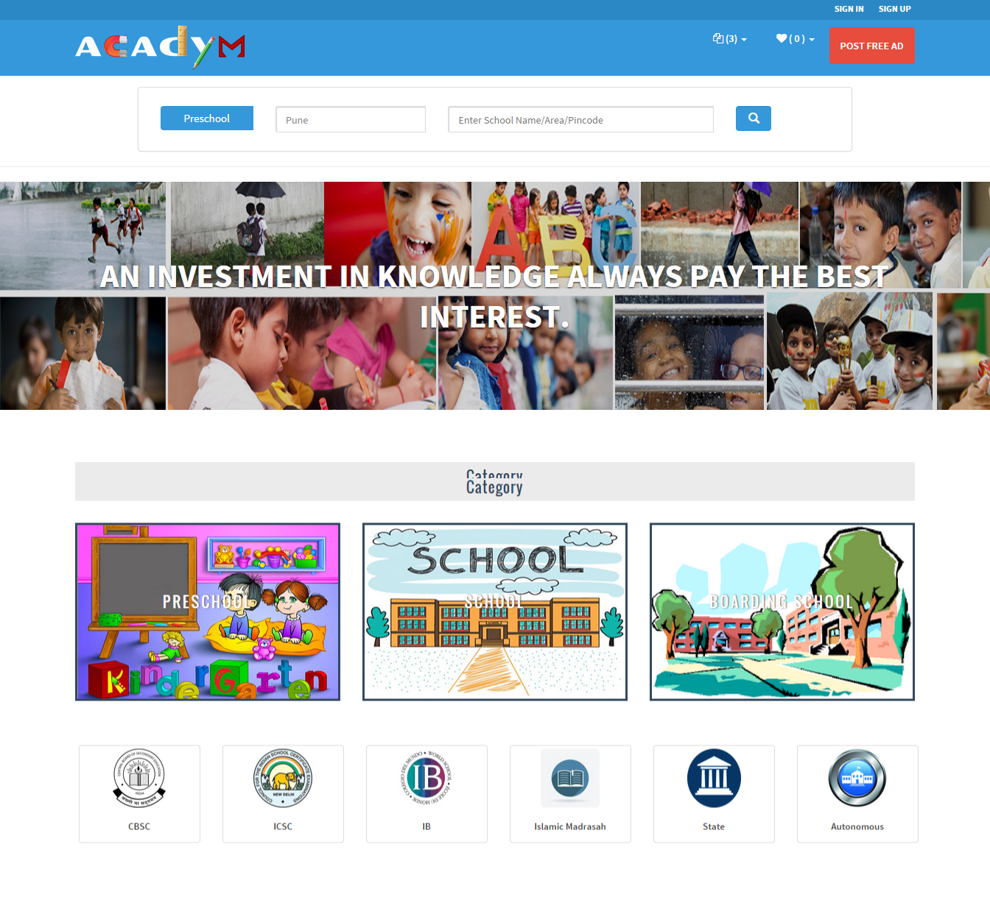
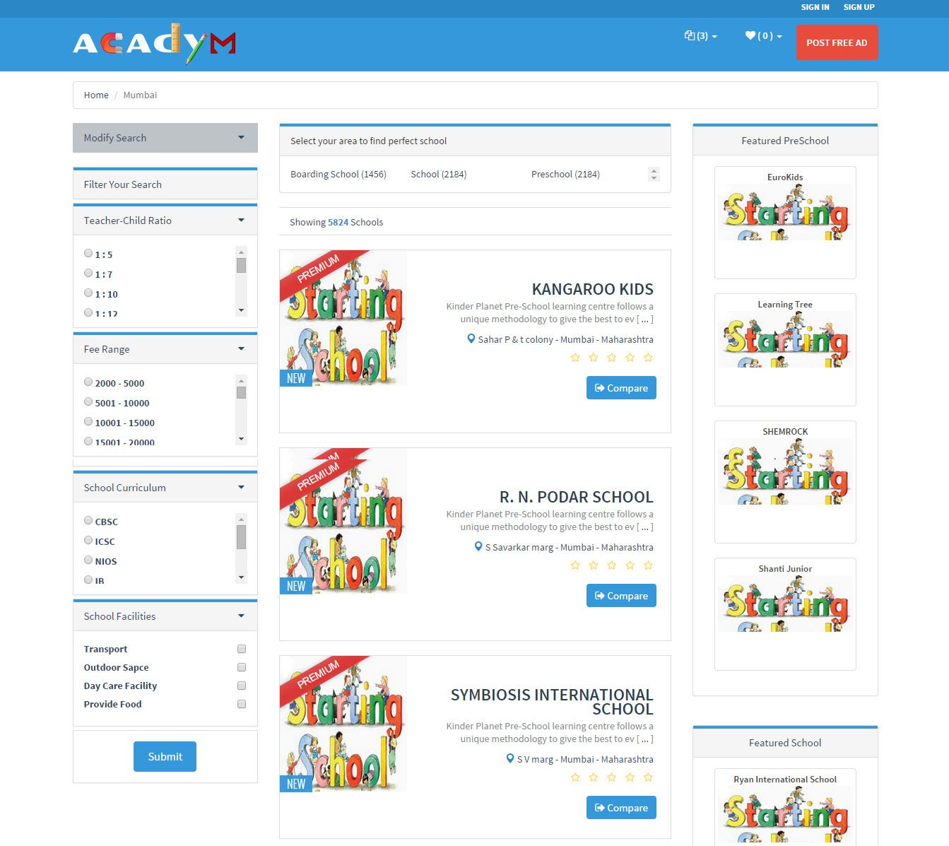
SCREEN SHOTS

Slide 11
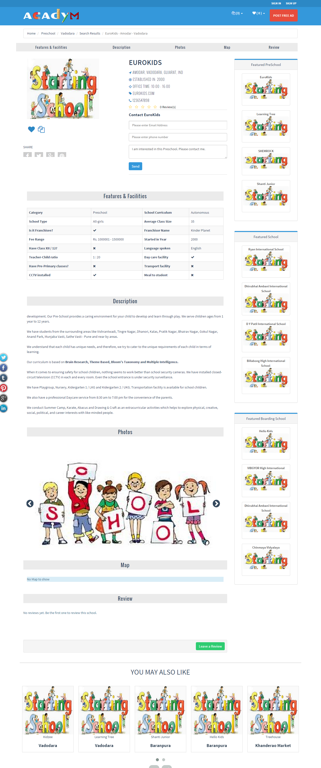
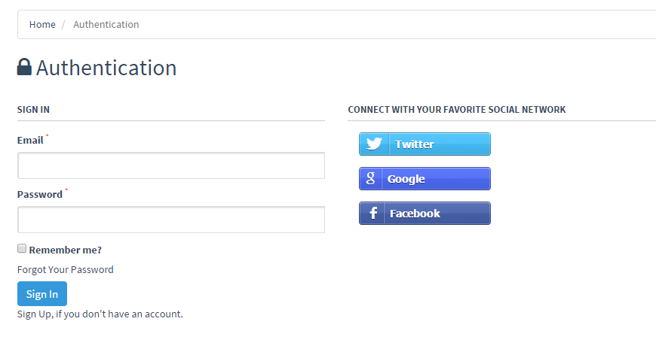
SCREEN SHOTS

Slide 12
THANK YOU
ACADYM
Free School Classified Ads

