Slide 1

Free School Classified Ads

Slide 2
WHAT IT IS
Acadym organise the school information and make it reachable and valuable to parents/users.
We help schools to promote their school on internet.
Acadym fundamental objective is to provide a leading, online classified advertising solution that targets schools in India.

Slide 3
WHAT PROBLEM IT SOLVES
Educational Institutes
Exclusive platform for Schools to list their school
Acadym is free to list ads.
Cost effective
Easy to penetrate local market
  Facility to provide school features and facilities like language spoken, teacher-child ration, CCTV installed, meal provided, Board, etc.
  Upload media
  Pin their address on map
  Communicable on social media

Slide 4
WHAT PROBLEM IT SOLVES
User
Acadym is free to use. Free to contact school by mail and phone.
Without visiting school location, user can shortlist the schools as per their requirement.
Contact school via email or phone.
Compare the schools.
No repository of school where they can search the school as per their criteria.
Communicable on social media.
Add and view reviews.

Slide 5
WHO IT SERVES
> 5 MM Schools
Preschool
Boarding School
School
Engineering College
ETC.
Medical College
Age Group
Age Group
Internet Users
Internet Users
25-54 years
55-64 years
550 MM
82 MM
Urban
Rural
194 MM
128 MM

Slide 6
TEAM/WHY YOU
We are having more than 14 years of experience in IT industry. We are well verse with latest technologies and best practices used in industry.
We have done lot of research for making idea into reality.
Current team comprise of UI developer and couple of programmer. We will be hiring marketing, technology and support to bring expertise in our team.

Slide 7
OTHER KEY POINTS
Acadym is a free classified and dedicated school ad website for Preschool, School, Boarding School and everything else in Educational Institute. Acadym will facilitate school to post their listing for free. Users will search the schools as per their criteria and shortlist it without visiting them. Acadym is free to use. Free to post an ad, free to browse listings, free to contact school.
We devote a great deal of time and effort in monitoring and filtering the content posted to the website, so you can be confident that you'll find only quality, relevant listings and reviews

Slide 8
OTHER KEY POINTS
Competitive Advantage
Cost Effective
Focus
Differentiation
User friendly website
Time saving
Design Approach
User friendly
Using latest technologies
All device readiness
Easy to navigate
Content rich

Slide 9
OTHER KEY POINTS - USP
Schools
100% free to list
Cost effective
Platform to promote their school
Communicable on social media
Pin business on map
Upload media
Users
100% Free to use
User can get a glance of school in single click
Search the schools as per their criteria's
Compare School
Local search engine
No need to go to each school
Communicable on social media

Slide 10
Create Free Ad - 3 EASY STEP
Sign Up
Create Your Ad
Upload Media
Take A Rest

Slide 11
Listing Plan
Basic
Free
Featured
Top of Search
Premium Ribbon
Highlight
Display in Pink color
Premium
Display on Right section
₹ 499 per month
₹ 249 per month
₹ 199 per month

Slide 12
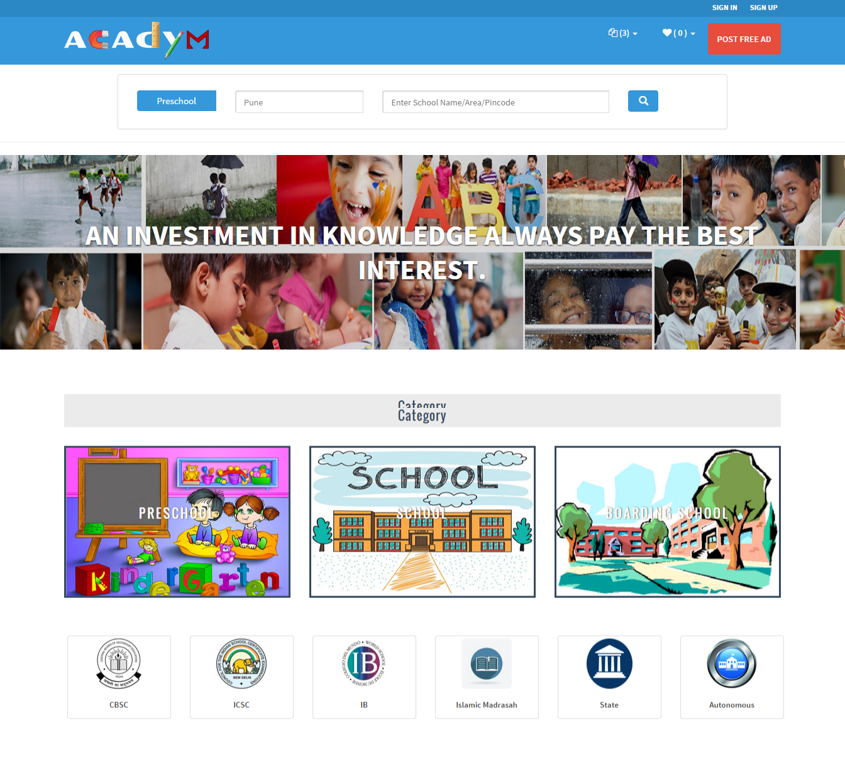
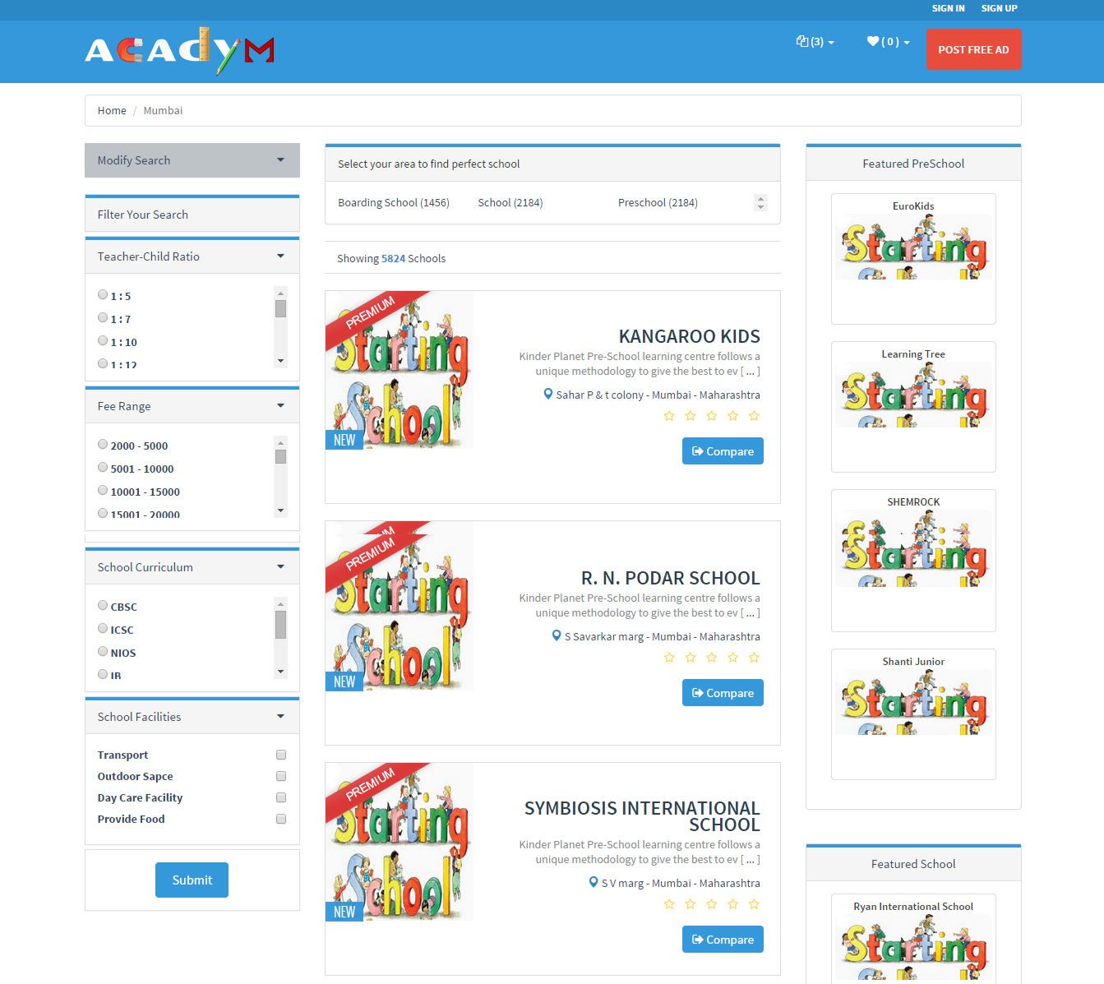
SCREEN SHOTS

Slide 13
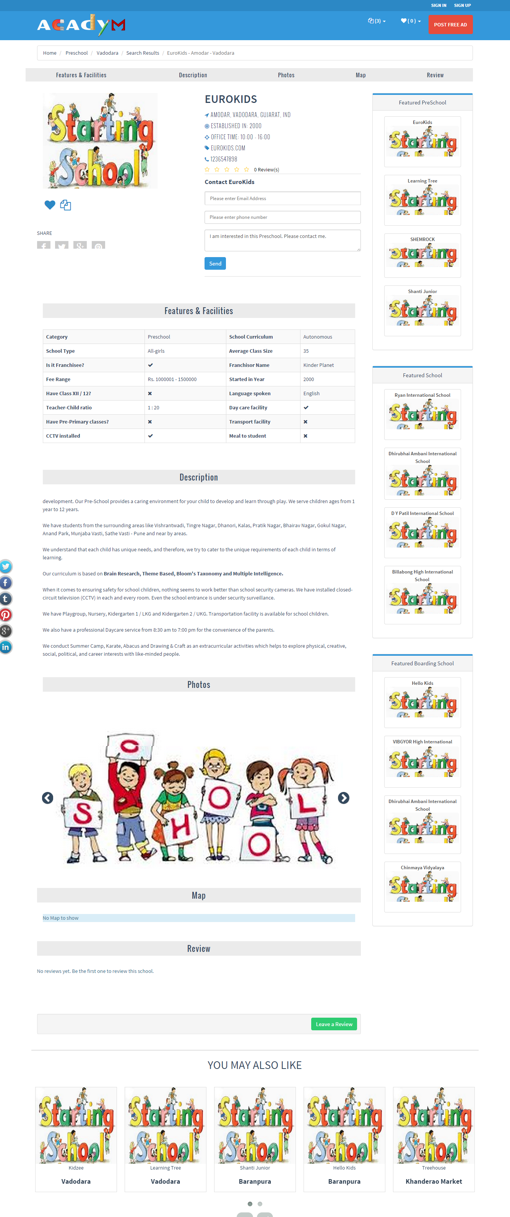
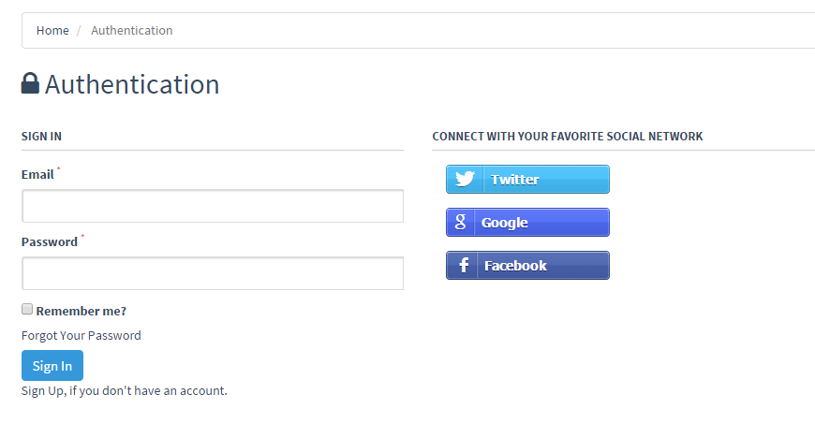
SCREEN SHOTS

Slide 14
THANK YOU
.com

