Slide 1

Improving Security Through Gunpowder Detection

Slide 2
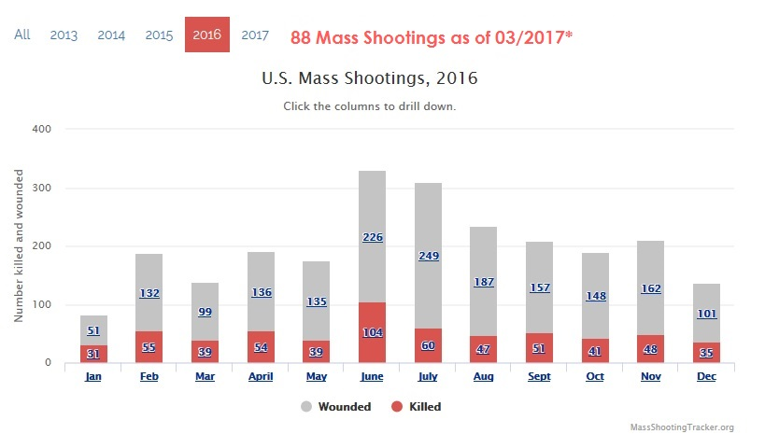

Could early detection of a concealed firearms have prevented some of these from happening?
On Average
112,695 people are shot
every year*
*Bradycenter.org

Slide 3
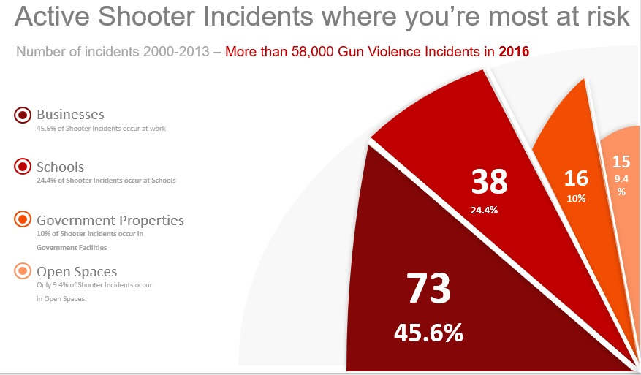
People have a greater chance of dying in a mass shooting if they are at School or Work
Active Shooter Incidents where you are most at risk

Slide 4
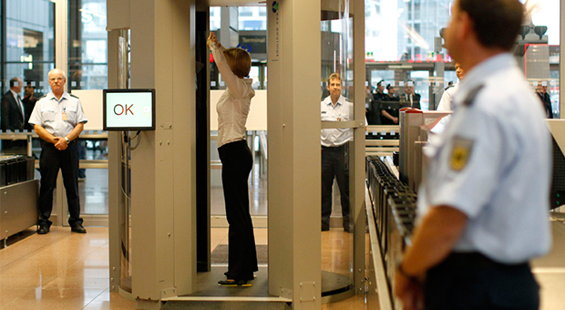
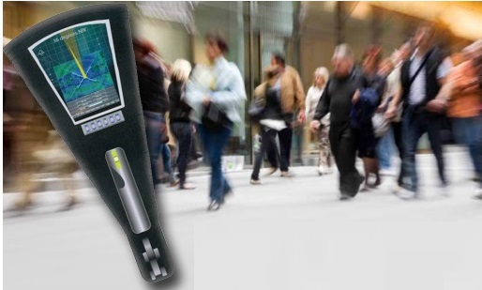
Gunpowder Detector
Affordable for All
Traditional-Expensive
Invasive-Dangerous
X-Ray Technology

Slide 5
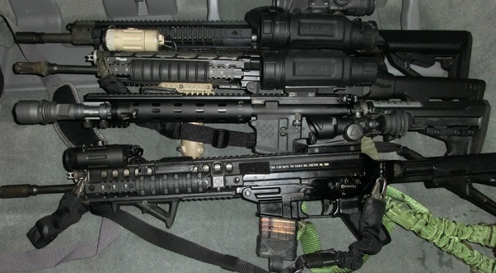
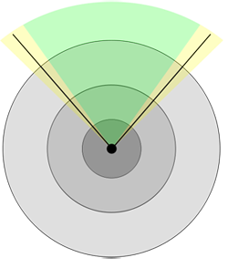

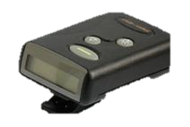
The Science
Guns Detected
Gunpowder emits a small emissions field that passes through normal obstacles.
Our technology captures these emissions and lets the user know there is gunpowder nearby.

Slide 6
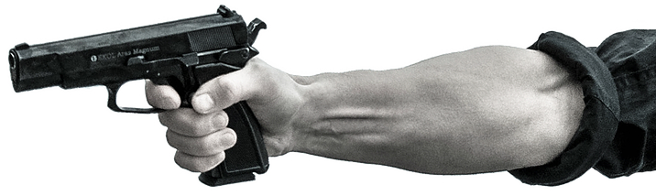
What can our gunpowder detector sensor do, and what are the Benefits?
No screening needed; bad-guys don’t know they’re being checked
Accurate and consistent; specific to smokeless gunpowder
Manage threats by detecting loaded guns from a distance, even concealed
Harmless to operators, targets and bystanders
Significant cost savings from more efficient searches
Doesn’t add to congestion at entryways
Detect loaded guns from a distance through virtually all types of barriers
day or night, in any weather
Discover hidden caches of loaded weapons in trucks, boats,
containers, trains, homes
Identify concealed weapons
within a crowd, before entering
buildings or events

Slide 7
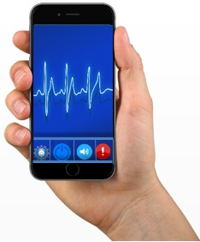



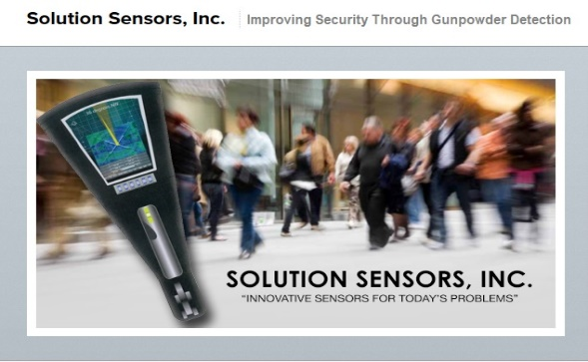

Our goal – 6 months to complete a user-friendly version of our sensor
We are working to convert
our technology into a digitized version that will be easy to use, and can be integrated
into wearable devices,
into entry-ways, and into
other forms. Once we have
done this, we will have a
unique technology that will
help enhance public safety.
After completing an initial
version of the device that
demonstrates the effective-
ness of the technology, we
conducted numerous
interviews with members of
law enforcement, of
government agencies, and
of security companies, and
received very positive feed
back from everyone we spoke with. This feedback has
re-assured us that having a
technology capable of
detecting concealed
firearms would provide greater peace of mind for law
enforcement, for parents, for business owners, and really
anyone who interacts with
the general public.
Easy to use with minimal chance of user error
Small enough to be carried for daily use
Accurate and reliable
Multiple Applications

Slide 8

Help Us Complete this Life-Saving Technology
Check out our donation PERKS for Contributors at http://www.LifeSavingSensor.com
Share our campaign with your friends on social media
Your contributions will enable us to accelerate the execution of our development plan. We will do this by expanding our technical team and working with our development partners to digitize and test the sensor. The more contributions we receive, the closer we will be to getting this technology into people’s hands.
Besides the monetary contributions, we look forward to forming a community of backers who believe in the importance of this, and to whom we can turn to for input. If you believe in the importance of what we’re trying to do, but don’t have the funds to contribute, you can still help us by sharing our campaign with your friends and on social media.
www.solutionsensors.org
Toll Free: 1-866-673-5475
info@solutionsensors.org
**Images are for illustration purposes only. Actual product housing and application will vary based on industry & need

