Slide 1



Welcome to our Webinar
How To Select A RON Platform
By Secured Signing with Bill Gimbel & Roger Castile
How to select a Remote Online Notarization Platform

Slide 2
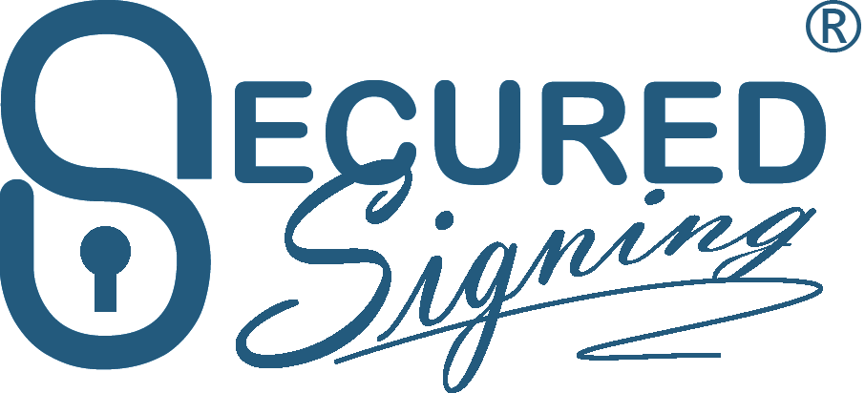

Who Is Secured Signing
a. Global company in 45 countries
b. ISO27001, SOC2*, HIPPA, MISMO certified
c. eSignatures, RON, RIN, IPEN & Hybrid
d. Smart doc capable and templates
e. 2 million unique users
f. ID verifications both domestic and internationals
Learn To Earn with Secured Signing’s Bill Gimbel & Roger Castile
securedsigning.com

Slide 3
Assumptions
You are building your own brand and developing your own clients
Markets: Legal, Medical, Financial, Construction, Insurance, Institutional +
You need a competitive wholesale price with a good ROI
Your State allows RON and maybe RIN, IPEN & Hybrid across various markets
You thoroughly understand your states notarial provisions
How to select a Remote Online Notarization Platform

Slide 4
Listed (if required) as an approved platform in your state
eSignature/RON, IPEN, RIN, Hybrid – White-label, Turnkey, Incl. Invites
Is the screen share software secure and not disallowed by your SOS
Is the journal, which the recording is part of, under notaries exclusive control
Is the platform ISO27001, SOC2, HIPPA or MISMO certified
Does the platform require Multi-Factor Authentication to gain access
Training: eLearning videos, self-help site guides, live webinars, help desk
How to select a Remote Online Notarization Platform

Slide 5
8. Does platform provide options for both journal storage/backup/self
9. Does the Journal auto-populate or does it require separate entry
10. Will platform store/make available journal after you stop being a notary
11. Does platform provide it’s own competency/certification test
12. All acts supported Ack, Jurat, Witnessing, Cert. copy, Conf. of life, Depos
13. All ID verifications (Personally Known, KBA, CA, Biometric, Credible witness)
14. Does the platform allow for international client use (non-U.S. citizens)
15 . Ability to verify non-U.S. citizen identities domestic/international
How to select a Remote Online Notarization Platform

Slide 6
16. x509 digital signature certificate yours (preferred) or the platforms
17. Does clicking on your applied signature vet/link to a Certificate Authority
18. Platform alert/allows you to proceed if a statutorily step is not completed
19. Is an audit trail available for you to download and provide clients/signers
20. Signature created by font, upload, draw pad, screen or cell phone
21. Auto advance to the next signer entry element signature/data/election
22. Execute signer side transactions across all mediums, cell, iPads, tablets etc.
How to select a Remote Online Notarization Platform

Slide 7
22. Switch live between devices to finish/start a session
23. Auto reconnect if internet disconnected & Signer instructional videos
24. White-label promotes your brand including email invite/reminders/finish
25. Screen sync to defined location to display a specific page/paragraph
26. Support multiple signers in same session, including observers
27. Ability for multiple attendees to sign in from different locations/devices
28. Ability to reschedule a signer that is delayed but continue with the others
How to select a Remote Online Notarization Platform

Slide 8
30. Read smart tagged documents so tagging not required, Incl. templates
31. Create Hybrid sessions for eSignature and notarial events separately
32. Fee for Sign Up: Monthly/Annual/Per Transaction
33. Does platform allow you to bill Clients/Signers separately and in advance
34. Does platform provide price estimator to calculate wholesale fees
35. Is there a cap on total wholesale fees charged per session(s)
36. Credit for cancellations/reschedules/partial sign/no signs etc.
37. Will platform staff assist you in sales presentations
How to select a Remote Online Notarization Platform

Slide 9

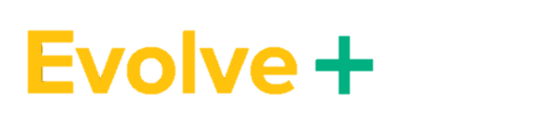
Q&A
Platform comparison chart available
Bill Gimbel
VP Business Development
bill.gimbel@securedsigning.com
www.securedsigning.com
Roger Castile
SVP, National Sales
roger.castile@securedsigning.com​
www.securedsigning.com​
How to select a Remote Online Notarization Platform
Learn To Earn with Secured Signing’s Bill Gimbel

