Slide 1

Context Analytics, Inc.
Generative AI Product
ContextAnalytics-AI.com
ContactUs@ContextAnalytics-AI.com

Slide 2
Generative AI Summaries For US Equities
Collects tweets from diverse sources, ensuring a wide array of opinions and information
Provides an easy-to-digest summary of the overall conversation surrounding the security, highlighting key conversation topics and trends
Helps investors make better informed decision-making, deeper insights into market sentiment, risk management and time efficiency

Slide 3
Real-Time Data Feed via API
Allows seamless integration of tweet data into your existing infrastructure through an API
Ensures continuous monitoring and real-time data ingestion
API endpoints can be tailored to specific needs and preferences
Immediate access to the latest tweet data, enhancing timely decision-making and investment strategies

Slide 4
Summarization on Front-End Platform
Available on our front-end ActiveTraders Platform for easy access and interpretation
Includes an array of sentiment metrics, charts, graphs and a real-time Twitter feed
Convenient access to summarized tweet data for all US Equities, enabling quick insights and effective trading strategies
Email alerts are available for set up so users can stay informed on what is being said on Twitter about the securities they’re interested in

Slide 5
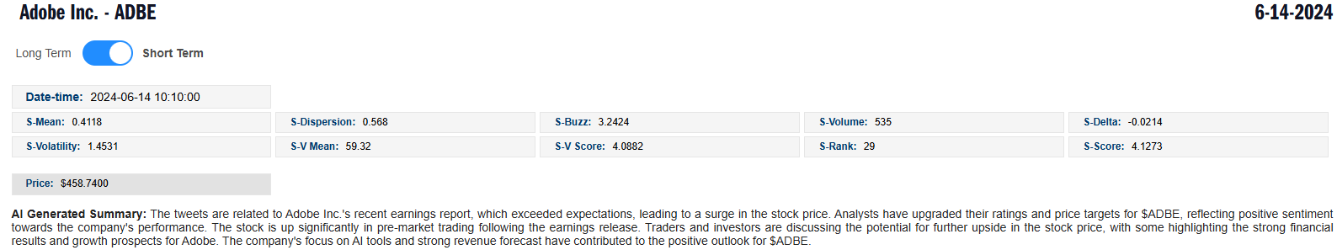
Front-End AI Generated Summary
Summaries are available for U.S. Equities refreshing daily at 9am ET.
The security must have five or more Tweets on the topic to be shown.

Slide 6
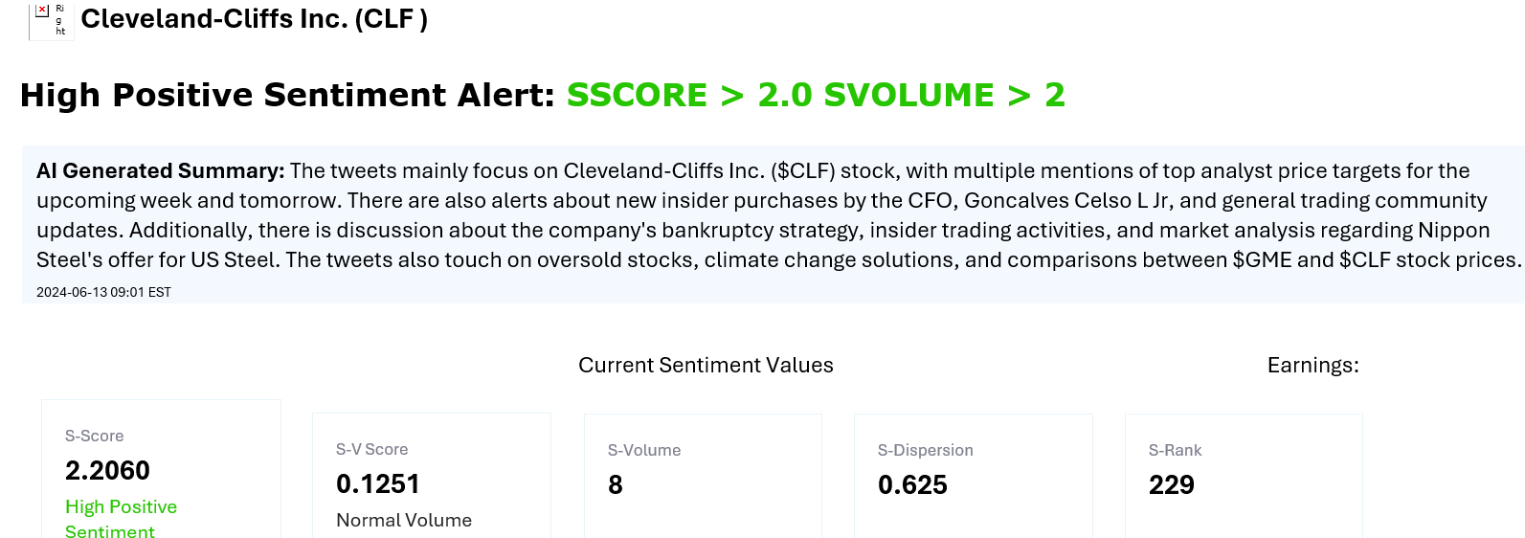
Front-End Email Alert

