Slide 1


THE INDISPENSIBLE GUIDE FOR THE HISPANIC ENTREPRENEUR

Slide 2
TABLE
CONTENTS
of
01
ABOUT US
02
TALENT & SKILLS
03
OUR READERS
Detail about our company
Our awesome talent and skills
Print and digital reader profile
04
DISTRIBUTION
05
PORTFOLIO
06
HISPANIC ADVERTISING
Our customers
What are the big players doing?
07
FACTS & FIGURES
Hispanic purchasing power
(consumer, businesses and media spending)

Slide 3

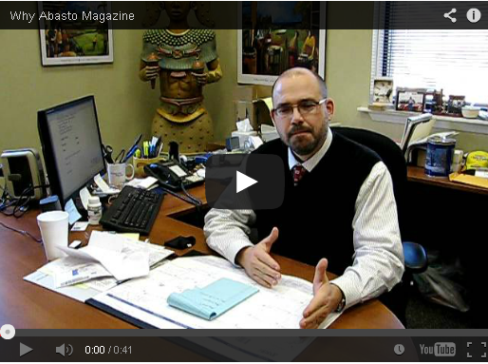
01
ABOUT
163
Abasto Media and HMC Inc.
companies have chosen us!
Abasto Media is part of Hispanic Marketing Consultants Inc. dba HMC
HMC serves as a marketing research entity in conjunction with Abasto Media
Abasto Media is the only source of business information in Spanish for the Hispanic business owner in the United States.
Abasto print and digital publication caters to the business owner, purchasing and logistics managers of distributing centers, supermarkets, tiendas and bodegas all across the U.S.
Goya Foods, Coca-Cola Mexico, Little Caesars, Vilore, JBS Swift, Minsa, Maseca, Marquez Brothers,Mexilink, Mexibrands, and many more.
Why Abasto?

Slide 4
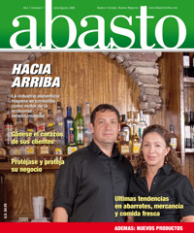
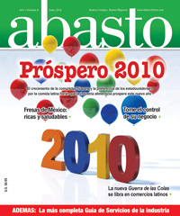
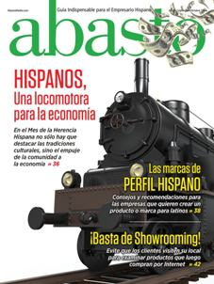
HISTORY
01
HOW WE GOT STARTED
THE BEGINNINGS 2008
GROWTH 2009-2011
2011-PRESENT NEW GOALS
Abasto Magazine was born six years ago in 2008. The
brainchild of Dan Calhoun,
he envisioned the
Publication as a bridge
between the manufacturers
and producers of Hispanic
products and the buyer.
Dan Calhoun together with
his two brothers are the
owners of one of the largest food and beverage Hispanic distributing companies in the Southeast.
.
During this period the
publication had a fair
growth in editorial content
as well as in advertisement,
however changes were
made in 2011 order to
Increase revenue and
exposure.
These changes include
distribution analysis and
corrective measures as
well as a slight change in size to accommodate the print magazine to new postal regulations.
Abasto Magazine,
now Abasto Media has became
the leading source of
Information for the Hispanic
decision maker in the food
and beverage industry. Just last
year Abasto Media sponsored
seven different Hispanic and
non-Hispanic trades shows
and it is establishing
the publication in a cross-cultural
environment. Our website presence increased in the last year and our E-Newsletter is read by over 8,000 professionals in the industry.
.

Slide 5
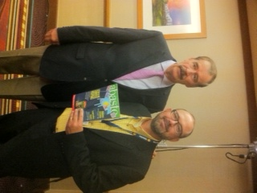
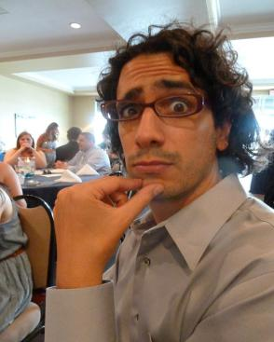

&
02
TALENT
A group of creative individuals facing
the everyday challenges of a publishing
company
Ivan Cruz
Editor
Dan Calhoun
CEO & Publisher
Ivan Cruz
Editor
Daniel Dau
Art Director
Gus Calabro
Operations Director
NEWS
OPINION
BUSINESS
PRODUCT RELEASES
TIPS & SUGGESTIONS
SKILLS

Slide 6
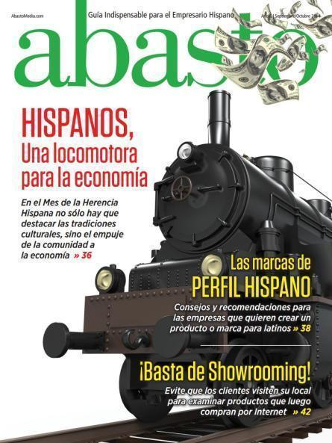
03
WHO ARE
Print
Profile
Digital
Profile
OUR
READERS
It is important to establish a difference between the readers of our print publication and digital publication.

Slide 7
WHO ARE OUR READERS
03
Print
Profile
Plain and simple, the readers of our print magazine are found in the following categories:
SMALL GROCERY STORE OWNER
(Small markets, tiendas and bodegas)
LARGE GROCERY STORE OWNER, PURCHASING MANAGERS
LOGISTICS SUPERVISORS, BUYERS
(Large supermarket chains)
LARGE AND SMALL DISTRIBUTORS
(La Tortilleria, Diaz Foods, etc…)
MANUFACTURES AND PRODUCERS
(Sales force, purchasing managers
ADVERTISING AGENCIES, TRADE SHOWS

Slide 8
WHO ARE OUR READERS
03
Digital
Profile
Plain and simple, the readers of our print magazine are found in the following categories:
SMALL GROCERY STORE OWNER / Millennials
(Small markets, tiendas and bodegas)
LARGE GROCERY STORE OWNER, PURCHASING MANAGERS
LOGISTICS SUPERVISORS, BUYERS
(Large supermarket chains)
LARGE AND SMALL DISTRIBUTORS
(La Tortilleria, Diaz Foods, etc…)
MANUFACTURES AND PRODUCERS
(Sales force, purchasing managers.
ADVERTISING AGENCIES, TRADE SHOWS AND ORGANIZATIONS

Slide 9
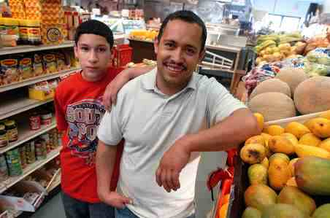
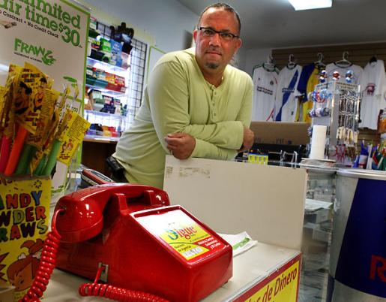
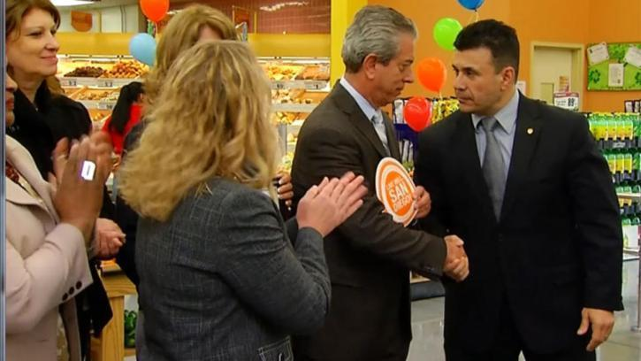
WHO ARE OUR READERS
03

Slide 10
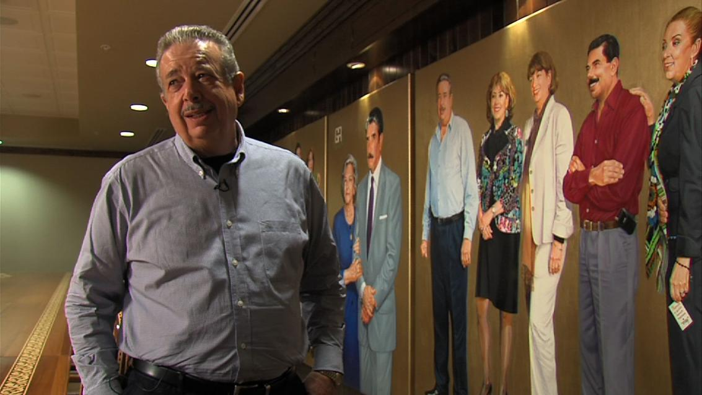

WHO ARE OUR READERS
03

Slide 11
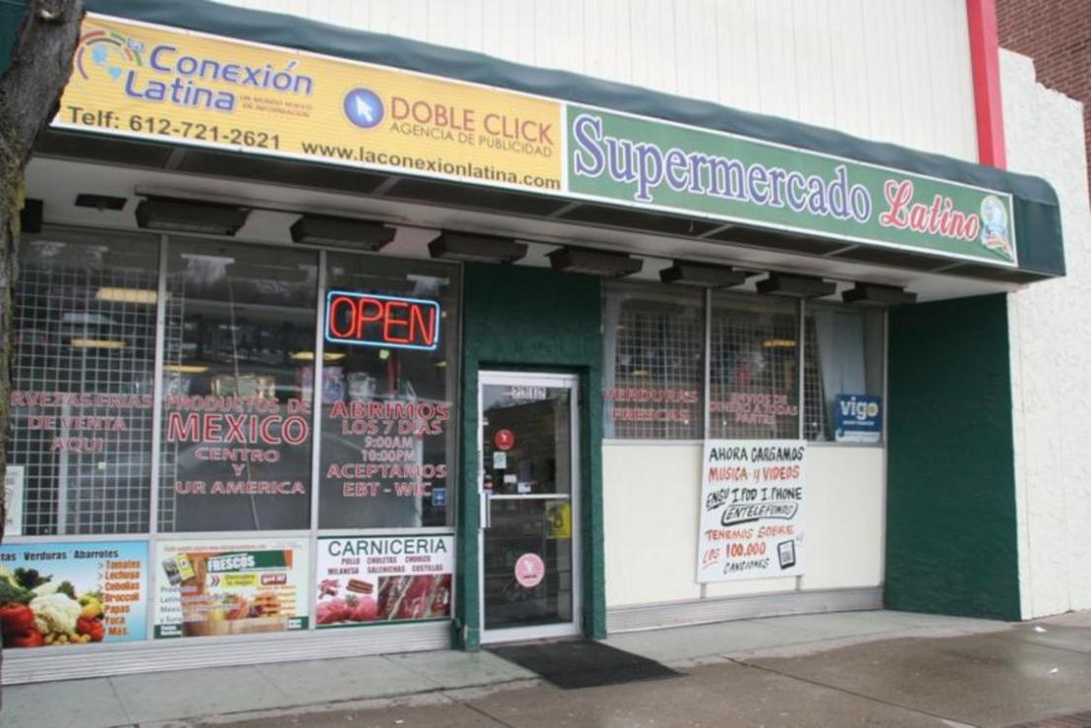
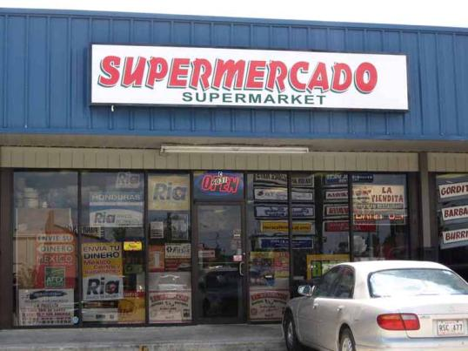
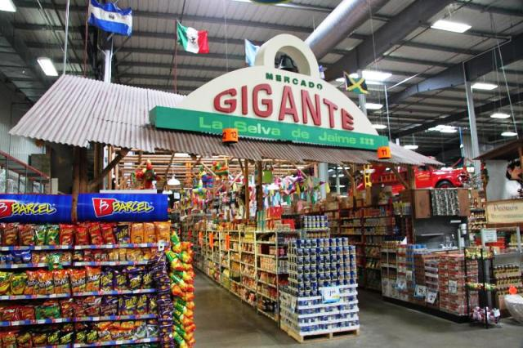
03

Slide 12
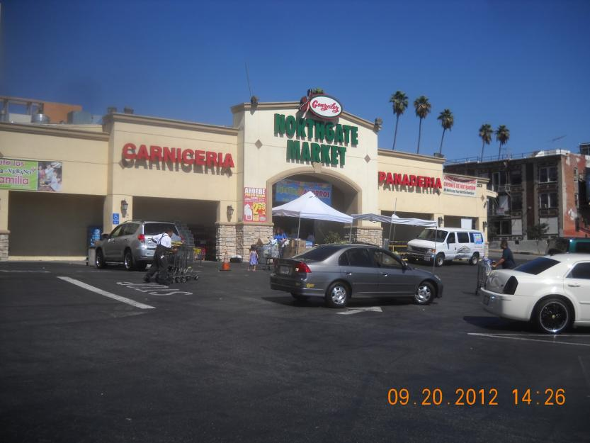
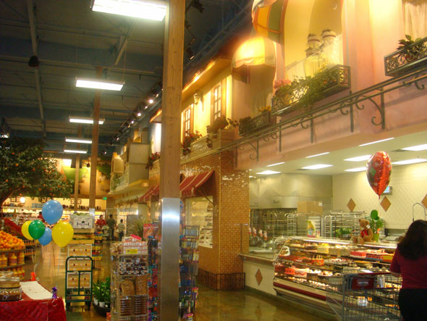
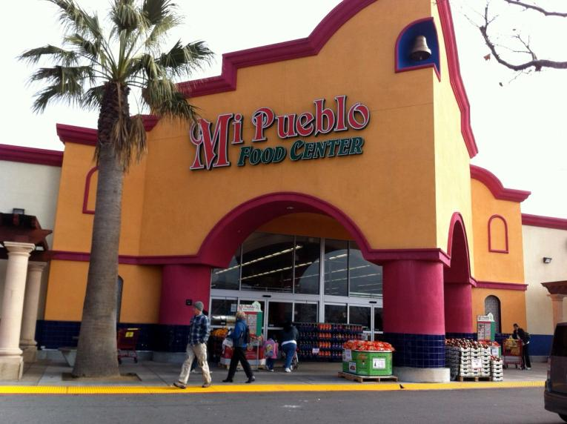
03

Slide 13
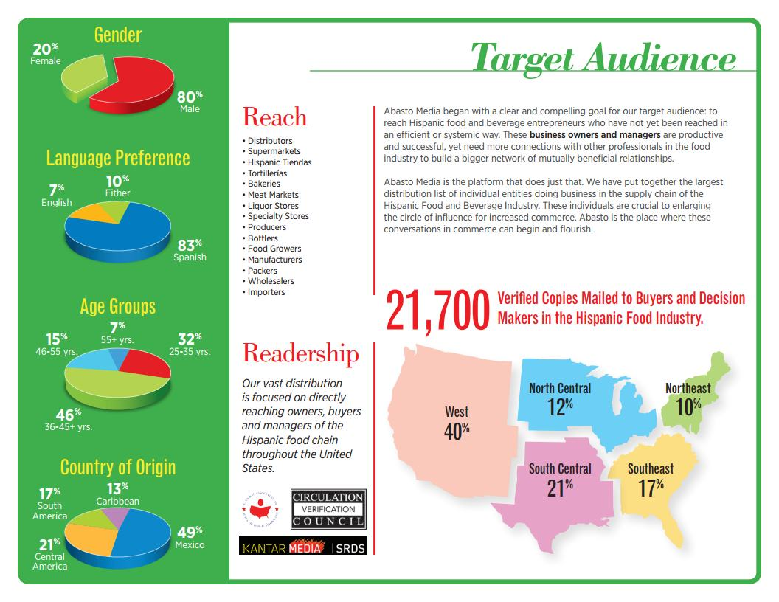



DISTRIBUTION
04
We distribute over 21,700 CVC verified copies every two month to Hispanic:
Distributors
Supermarkets
Tiendas
Tortillerias
Bakeries
Meat Markets
Producers
Wholesalers
Importers
and more.
Take a look at our media kit for a more detailed information

Slide 14
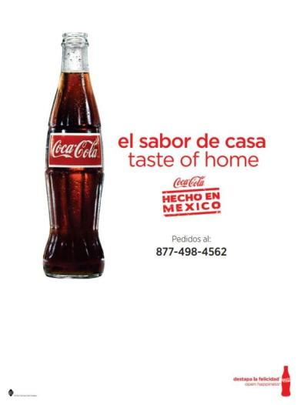

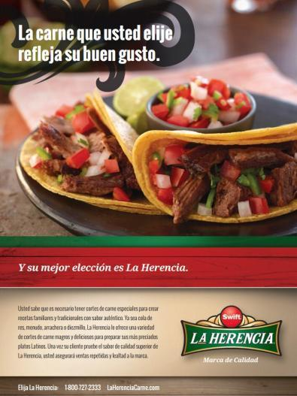
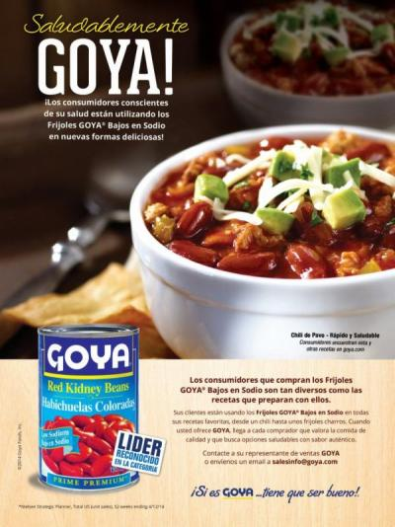
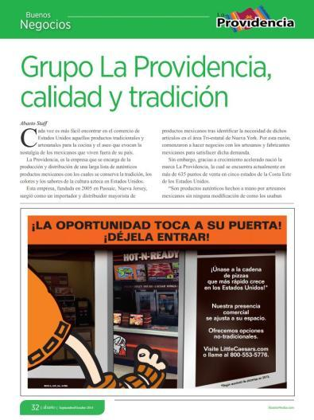
PORTFOLIO
05
Some of our customers
Coca-Cola
Penske
JBS-Swift-La Herencia
Goya Foods
Little Caesars

Slide 15
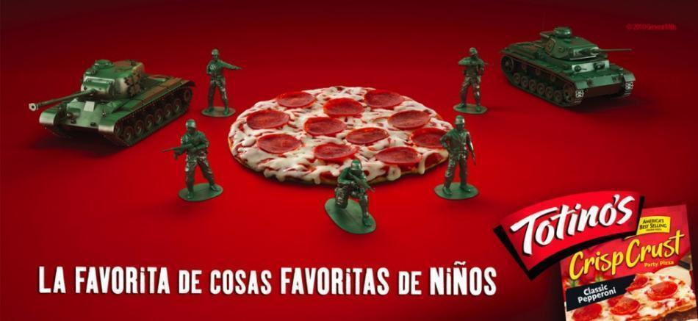




HISPANIC ADVERTISING
06
Target
Macy’s
General Mills
Kellogg’s
NAPA Auto parts

Slide 16
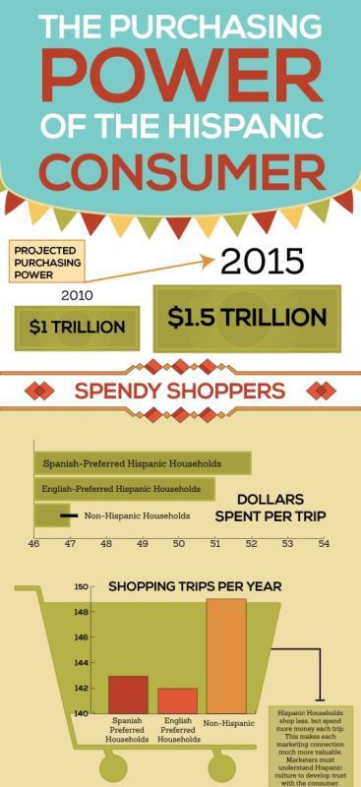
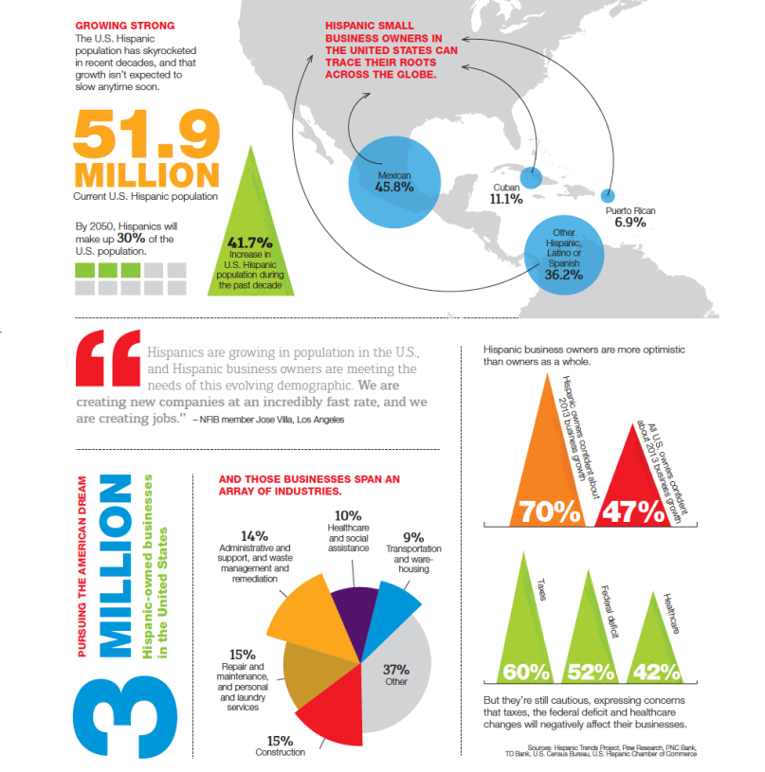

FACTS & FIGURES
07

