Slide 1


A Time to Act
COVID-19 Academic Slide in New Jersey
Fall 2020 - Winter 2021

Slide 2
COVID has the potential to drastically exacerbate the educational inequities in New Jersey for an entire generation of students….
A Time to Act examines the impact of COVID on New Jersey student learning by using student data from grades 3-8 to answer three primary questions:
How has student academic growth changed since schools shifted to distance learning due to the pandemic?
Based on the 2020-21 achievement data, how many students are on track to score proficient on statewide assessments (NJSLA), if offered this Spring?
Do the results differ based on student demographic groups?

Slide 3
Key Findings: Proficiency rates are projected to be slashed nearly in half for ELA and more than half for Math
A majority of New Jersey’s students in grades 3-8 started the 2020-21 school year significantly behind
And more students were pushed off course in the Fall and Winter of this school year — the COVID slide deepened as students lost expected academic growth
  ELA: 24 percentile point drop projected on New Jersey Student Learning Assessment (NJSLA)
    Actual Spring NJSLA 2019 proficiency: 58%
    Estimated Fall 2020 proficiency: 39%
    Expected Spring 2021 proficiency: 34%
  Math: 23 percentile point drop projected on NJSLA
    Actual Spring NJSLA 2019 proficiency: 45%
    Estimated Fall 2020 proficiency: 29%
    Expected Spring 2021 proficiency: 22%
Now, only one-third of students in ELA and less than one-fourth of our students in Math are expected to be proficient
Our low-income Black and low-income Latinx students are falling even further behind

Slide 4



These findings estimate that if state tests were given this Spring, 143,132 fewer NJ students in grades 3-8 would meet grade levels in ELA, bringing the total number of students not proficient to 393,613
Spring 2019
ELA Proficiency
Spring 2021 (Estimated)
ELA Proficiency
58%
345,901 students
143,132 students
34%
202,769 students
596,382 students in grades 3-8 in 2019
345,901 students proficient in 2019
250,481 not proficient in 2019
596,382 students in grades 3-8 in 2019
202,769 students estimated proficient in 2021
393,612 students estimated not proficient in 2021

Slide 5
These findings estimate that if state tests were given this Spring, 129,002 fewer NJ students in grades 3-8 would meet grade levels in Math, bringing the total number of students not proficient to 437,488
Spring 2019
Math Proficiency
Spring 2021 (Estimated)
Math Proficiency
45%
252,396 students
129,002 students
22%
123,394 students
560,882 students in grades 3-8 in 2019
252,396 students proficient in 2019
308,486 not proficient in 2019
560,882 students in grades 3-8 in 2019
123,394 students estimated proficient in 2021
437,488 students estimated not proficient in 2021

Slide 6


COVID Academic Slide Methodology

Slide 7


How we approach this
EmpowerK12 supported data collection and analysis for this study. EmpowerK12 is a nonprofit specializing in education data systems, strategic analysis and research, and improvement science best practices that translate data into action. For this study, EmpowerK12 looked at data from MAP and i-Ready, described below:
NWEA Measures of Academic Progress (MAP) By dynamically adjusting to each student’s performance, MAP Growth creates a personalized assessment experience that accurately measures performance -- whether a student performs on, above, or below grade level.
i-Ready Diagnostic (i-Ready) is an adaptive assessment that pinpoints student ability level, identifies the specific skills students need to learn to accelerate their growth, and charts a personalized learning path for each student.

Slide 8
Focused analysis to see how students are performing halfway through the school year
Percent of typical Fall to Winter growth met: students receive a winter growth target based on where they score in the Fall and the typical amount of growth made by similar students over 5 months
On-track for NJSLA proficiency: utilizing a linking study from NWEA, we examined the percent of sample students whose Fall and Winter NWEA MAP scores put them on-track to earning NJSLA proficiency in Spring 2021
Average national percentile rank changes: Fall national studies focused on change in average percentile rank from last year to this year — essentially, they compare how Fall scores would have ranked in the pre-COVID 2019-20 school year; we also analyze changes in percentile rank for key student groups
Fall 2020
Winter 2020

Slide 9

COVID Academic Slide Results

Slide 10
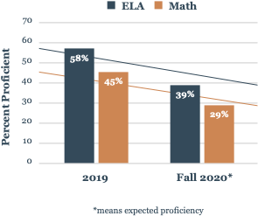
A majority of NJ’s students started the 2020-21 school year significantly behind due to the COVID slide
Using the achievement data collected in this study, and consistent with other national studies, we know that students in Fall 2020 were already facing significant declines in their academic performance
Actual Spring 2019 NJSLA:
  58% of students were proficient in ELA
  45% of students were proficient in Math
Fall 2020:
  only 39% of students estimated to be proficient in ELA
  only 29% of students estimated to be proficient in Math
Spring 2019-Fall 2020 COVID Slide:
  a drop of 19 percentile points in ELA estimated proficiency
  a drop of 16 percentile points in Math estimated proficiency

Slide 11
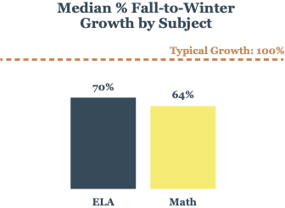
The COVID slide has deepened for New Jersey students due to slowed growth during the Fall and Winter of this school year
Using MAP and iREADY assessments, students receive a winter growth target based on where they score in the fall and the typical amount
of growth made by similar students over 5 months.
This Fall 2020 to Winter 2021:
On average, students in grades 3-8 lost 30% of expected learning in ELA
On average, students in grades 3-8 lost 36% of expected learning in Math
Pre-pandemic there were already learning gaps across NJ based on subgroups.
The following slides drill down into what this sample shows us is happening in those subgroups.

Slide 12
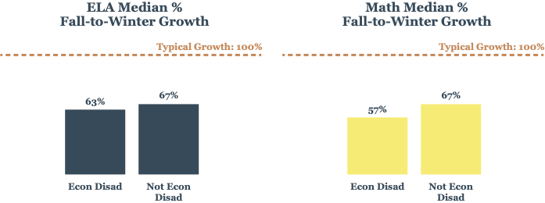
New Jersey’s economically disadvantaged students lost more ground in Math than their more affluent peers
Economically disadvantaged students experienced a similar loss in ELA as compared to their non-economically disadvantaged peers -- losing approximately 40% of expected learning
Economically disadvantaged students lost 43% of expected learning in Math this year compared to their more advantaged peers

Slide 13
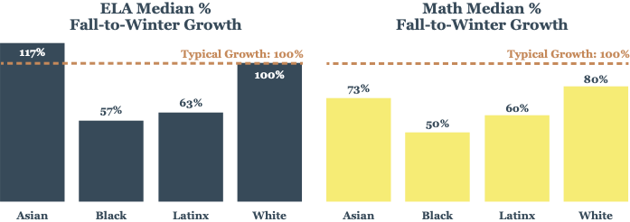
New Jersey’s Black and Latinx students lost more learning in both ELA and Math than their peers
ELA
  Black students on average lost 43% of expected learning this year
  Latinx students on average lost 37% of expected learning this year
Math
  Black students on average lost 50% of expected learning this year
  Latinx students on average lost 40% of expected learning this year

Slide 14
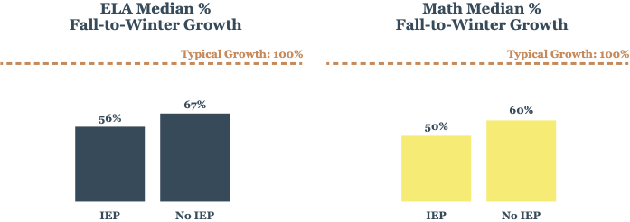
New Jersey’s students with disabilities also lost more learning than their peers without IEPs
Students with IEPs lost 44% of expected learning in ELA this year as compared to their peers without IEPs
Students with IEPs lost 50% of expected learning in Math this year as compared to their peers without IEPs

Slide 15
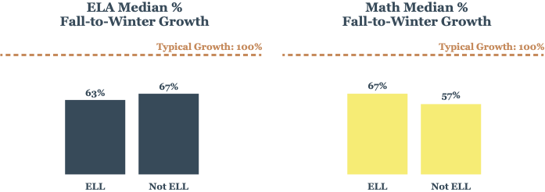
New Jersey’s English language learners out-performed their non-ELL peers in Math
In ELA, ELL students lost 37% of expected learning this year, which was slightly higher than their non-ELL peers
In Math, ELL students lost 33% of expected learning this year, which was slightly lower than their non-ELL peers

Slide 16
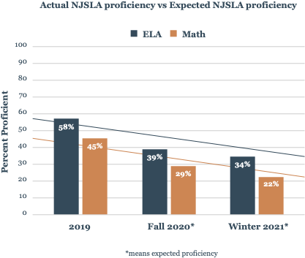
Lost learning in the first half of this school year means the COVID slide deepens...
It is projected that nearly 2 out of every 5 students who were previously proficient in ELA on the NJSLA are no longer on-track, and about 1 out of every 2 who were proficient in Math in Spring 2019 are not meeting or exceeding expectations anymore.
Spring 19-Winter 21 COVID Slide:
  an expected drop of 24 percentage points in ELA
  an expected drop of 23 percentage points in Math
Only 1 in 3 students may now be proficient in ELA
Only 1 in 4 students may now be proficient in Math
This means the vast majority of our students are no longer expected to be
on grade level as measured by NJSLA
We added a variable to the model to account for participating schools’ performance pre-pandemic and another to control for in-person vs. distance learning status. Both variables led to increases in state estimates compared to the sample. State projections are based on a model that uses weighted averages of sample students by race, ELL status socioeconomic status, and disability status to better reflect the demographics of New Jersey.

Slide 17
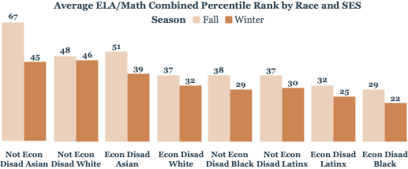
Achievement gaps are growing for low-income Black and
low-income Latinx students
Comparing ELA and Math average achievement to pre-pandemic national percentile ranks-- New Jersey student group outcome gaps have worsened
  To understand the graph below, if a student group has a national average percentile ranking of 60 from fall 2019, then that student group outperformed 60% of students nationwide in the same grade on average
  A national average percentile of 35 in fall 2020 means that those students outperform 35% of students in the same grade group pre-COVID.
Low-income Black and low-income Latinx students experienced larger percentile decreases in average achievement percentile rank this semester

Slide 18

Recommendations to Stem the COVID Slide

Slide 19





Recommendations to Stem the COVID slide and get students back on track
Urgently prioritize the adoption and statewide implementation of extensive summer programming so that we can stem the COVID slide now and further stop more students from falling behind;
Adopt and implement personalized, research-based solutions for accelerating student learning like high-dosage tutoring;
Allow parents to exercise their choice to retain or hold back their child, if desired, to provide additional time to students for learning and the provision of social and emotional supports;
Incentivize all districts to adopt high-quality instructional materials that are aligned to statewide assessments, which can provide teachers and parents with ongoing information about student academic growth and that can project proficiency on NJSLA; and
Administer statewide assessments in Spring 2022 that are comparable to those administered in Spring 2019 to establish a new baseline from which to measure student growth moving forward and to also enable comparisons to pre-pandemic statewide proficiency.

Slide 20

Acknowledgements
Thank you to the 15 New Jersey districts and charter schools who volunteered their data to make this study possible
Thank you to EmpowerK12 for their data and research assistance
This project was made possible through the generous support of the New Jersey Children’s Foundation
The New Jersey Children’s Foundation is a non-profit organization aimed at promoting a fact-based discussion about public education in New Jersey. Its mission is to invest in people, programs, and partnerships that will improve public education systems by putting the interests of children first.

Slide 21

Questions

Slide 22

Appendix

Slide 23
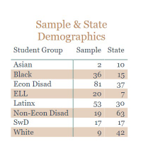
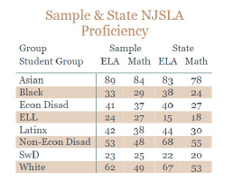
Our sample
Received Fall and Winter 2020-21 assessment data for more than 18,000 students from 15 school districts
Focused on students with “typical” testing characteristics -- about 8250 students
Used industry best practices by applying weighted averages to adjust this sample to match the demographics for New Jersey by race, ELL status socioeconomic status, and disability
Since there is variation in historical proficiency between the sample and state, we apply mathematical adjustments to model parameters to account for pre-pandemic achievement differences

Slide 24
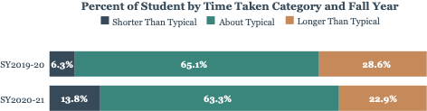
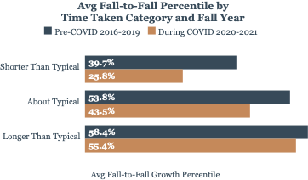
Testing during virtual learning
Many students took significantly less time to complete the test
  Students who rushed performed worse than expected compared to pre-pandemic data
  Study focuses on students with “typical” testing characteristics

Slide 25
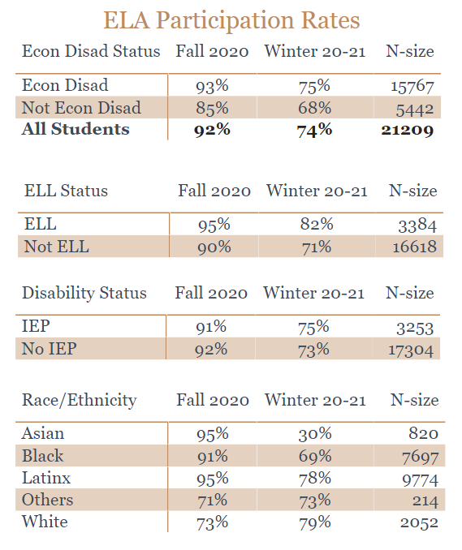
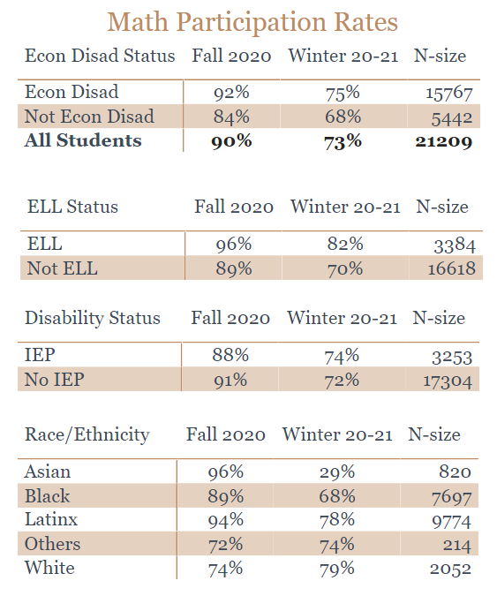
Test participation rates
Assessment participation rates were lower than typical pre-pandemic rates
Missing one-quarter of students from the winter data

