Slide 1


Add Table of Content to Flipping Book with 3DPageFlip Software
From: 3DPageFlip.com

Slide 2

Introduction
3DPageFlip.com is desktop publishing software company established in China. It provides flash page flip software for both PC and Mac users. You can create amazing page flipping book with its software. 3D PageFlip Professional and 3D PageFlip Standard are two hottest products selling on website.
The slideshow teaches you to use one of its great features, to create table of content for a flipping book in simple steps.

Slide 3


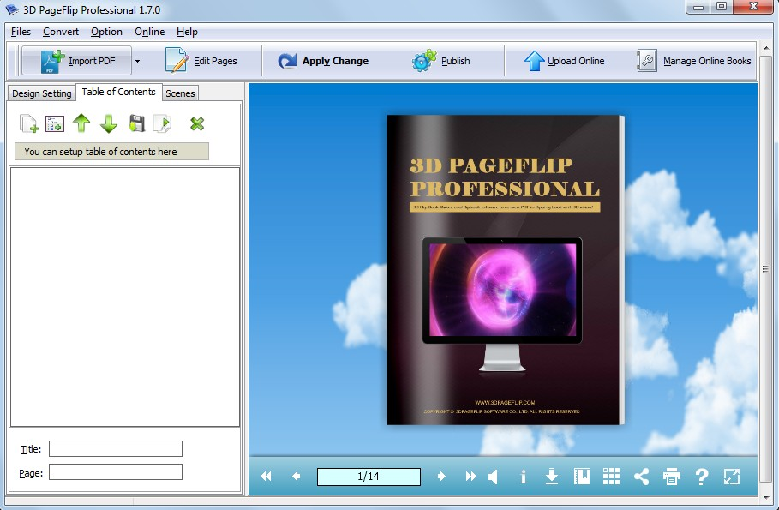
Step1, transfer left panel to “Table of Contents”

Slide 4

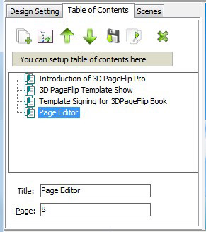
Step2, edit table of contents.
Add, move, import, output, and delete table of content
Edit title and page number

Slide 5
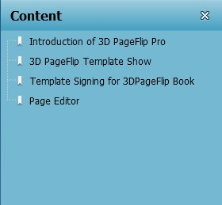
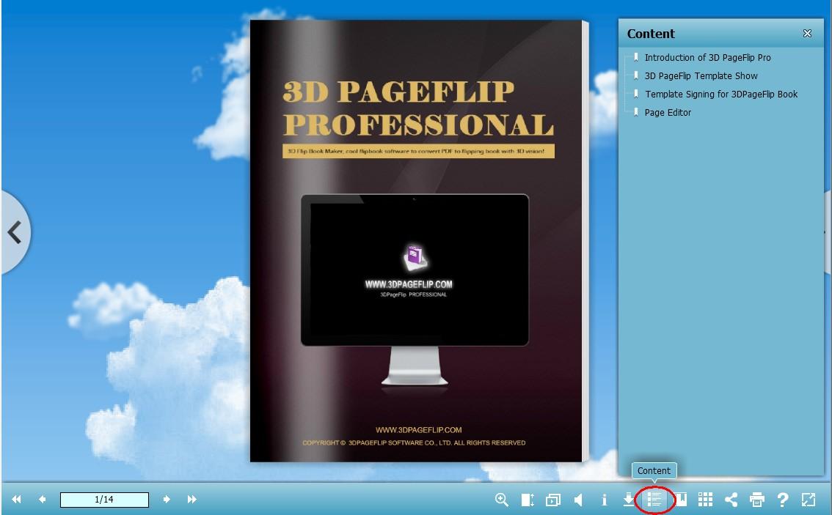
Step3, Apply Change to save your settings. Click “Content” icon in toolbar, the table of contents will present in the right of 3d page flip book

Slide 6


Thank you for watching!
From more information: 3DPageFlip.com

