Slide 1
Newarkers’
Views on Public Charter Schools
And Other Key Education Issues
December 2021

Slide 2



Background and Methodology
The New Jersey Children’s Foundation’s mission is to promote a fact-based discussion about public education in Newark. In service of this goal, NJCF commissioned a survey to understand Newarkers’ opinions on a host of relevant issues facing our public schools.
Change Research polled 431 registered voters in Newark, New Jersey from December 17-20, 2021. The margin of error as traditionally calculated is 4.71%. Post-stratification weighting was performed on gender, race/ethnicity, education, and zip code. Weighting parameters were based on census data and data from New Jersey’s voter file.

Slide 3
Key Findings

Slide 4
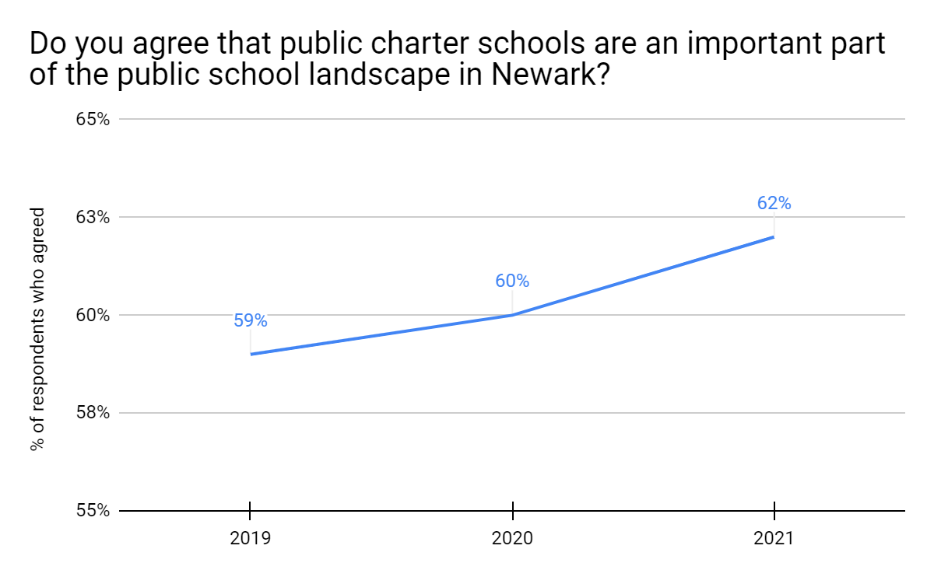
Newarkers Strongly Support Public Charter Schools
62% of Newark voters said public charter schools are an important part of the public school landscape in the city, up from 60% in 2020 and 59% in 2019.
By a 57%-23% margin, voters believe that public charter schools help improve public education in the city.

Slide 5
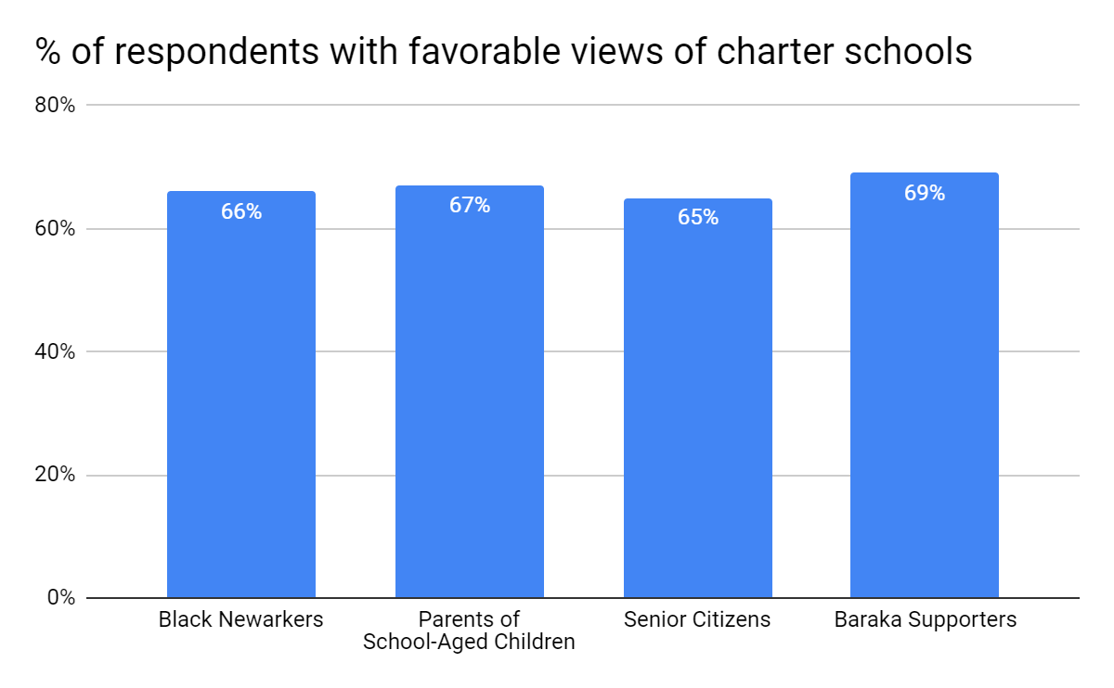
Charter Support - Crosstabs
Support for public charter schools is especially high among:
Black voters (66%)
Parents of children <18 (67%)
Senior citizens (65%)
Supporters of Mayor Baraka (69%)
Notes:
42% would be more likely to vote for such a candidate, 21% less likely.

Slide 6
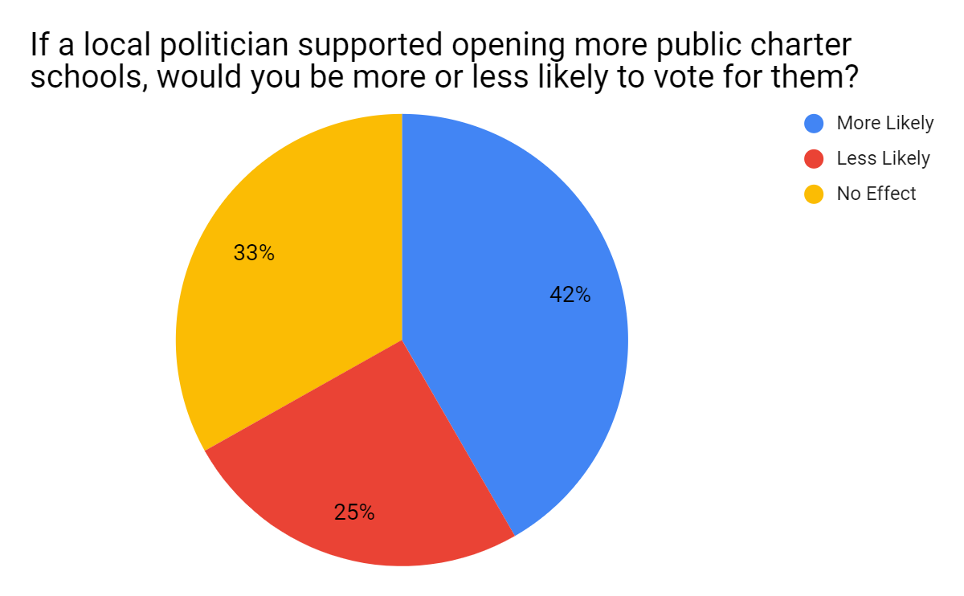
Newarkers Prefer Candidates Who Support Public Charters
By a 17-point margin, voters are more likely to vote for a candidate who supports expanding public charter schools.
Such a candidate would have an advantage with voters of all political affiliations, and with nearly every racial and ethnic group, age group, and gender.
Notes:
42% would be more likely to vote for such a candidate, 21% less likely.

Slide 7
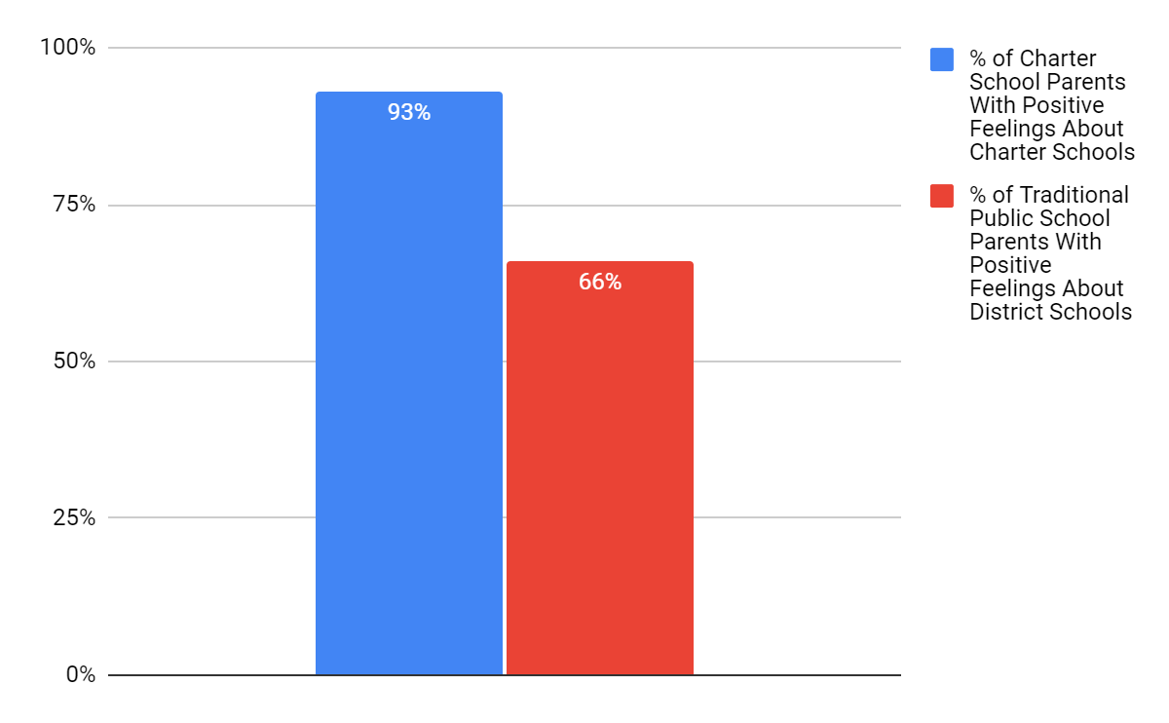
Charter School Parents Are Very Positive About Children’s Schools
Charter school parents are particularly enthusiastic about their children’s schools. 93% of charter school parents feel positively about their child’s school, compared with 66% of district parents who feel positively about their child’s district school.
Notes:
42% would be more likely to vote for such a candidate, 21% less likely.

Slide 8
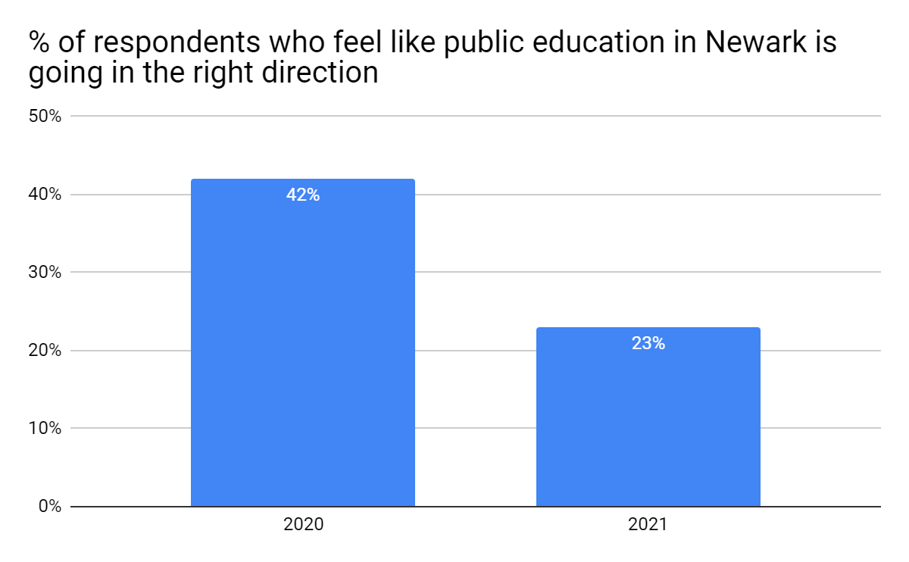
Newarkers Are More Pessimistic About the State of Education
The percentage of Newark voters who say education is on the right track fell by almost 20 percentage points, from 42% in 2020, to 23% in 2021.
Still, a plurality (44%) think that there are more high quality schools available to Newark families than there were 10 years ago.

Slide 9
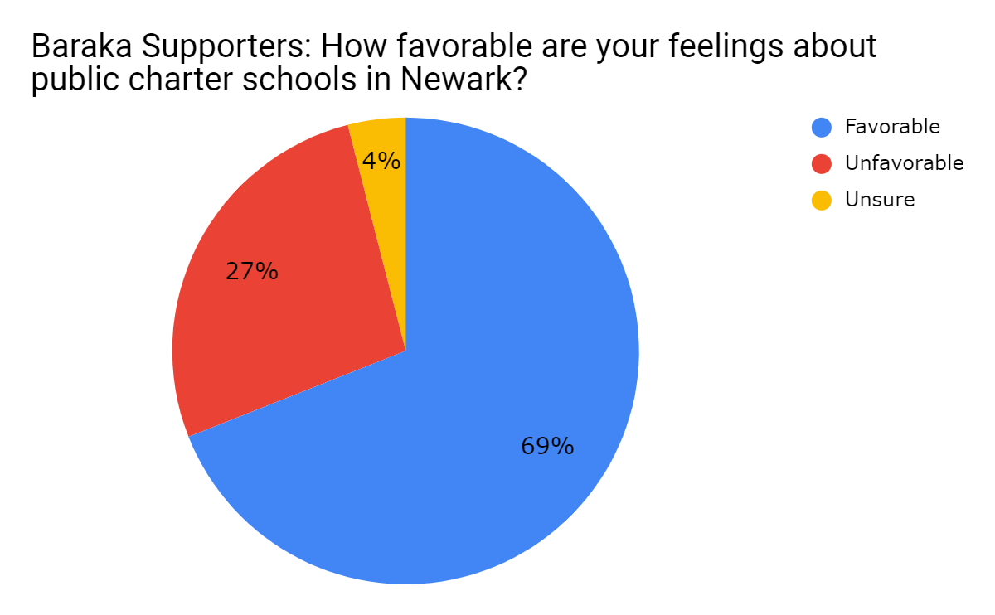
Mayor Baraka Has Strong Support for Re-Election, And His Supporters View Charter Schools Favorably
In a ballot test against a generic opponent, Mayor Baraka leads by 24 points (47%-23%).
Supporters of Mayor Baraka support public charter schools by a 42 point margin (69% favorable to 27% unfavorable).

Slide 10
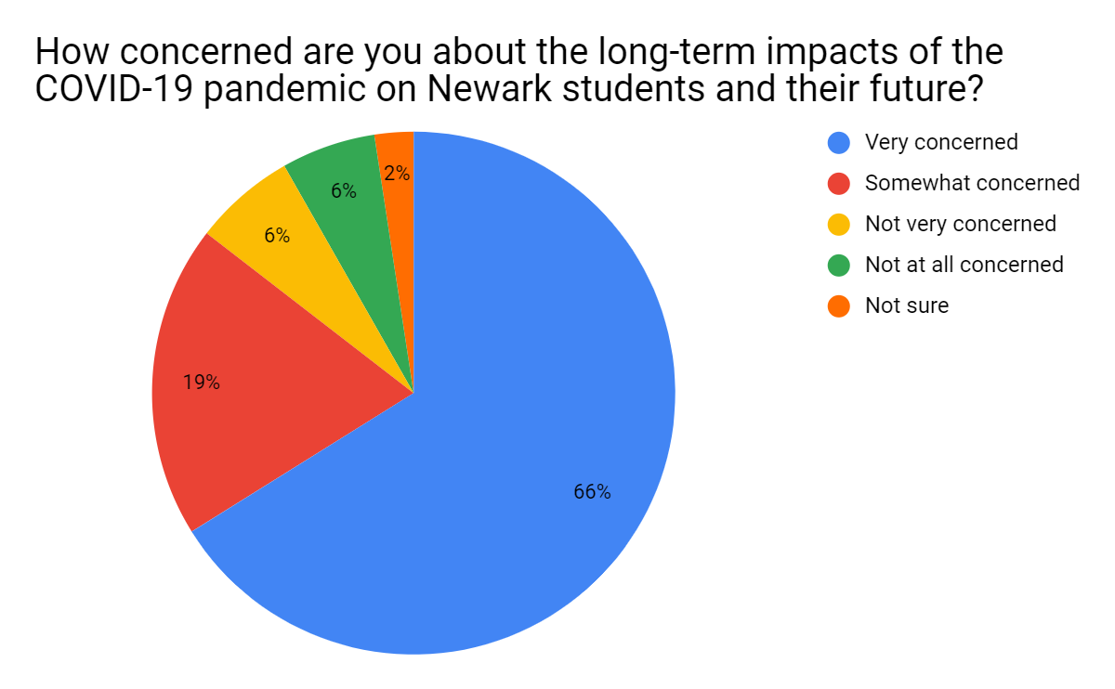
Newarkers are Very Concerned about Impact of COVID-19
85% of voters say they are concerned about the long-term impacts of the COVID-19 pandemic on Newark students and their future, and two-thirds (66%) report that they are very concerned.
42% say they aren’t confident that Newark’s local school leaders have a plan to address students’ learning loss due to the pandemic.

Slide 11
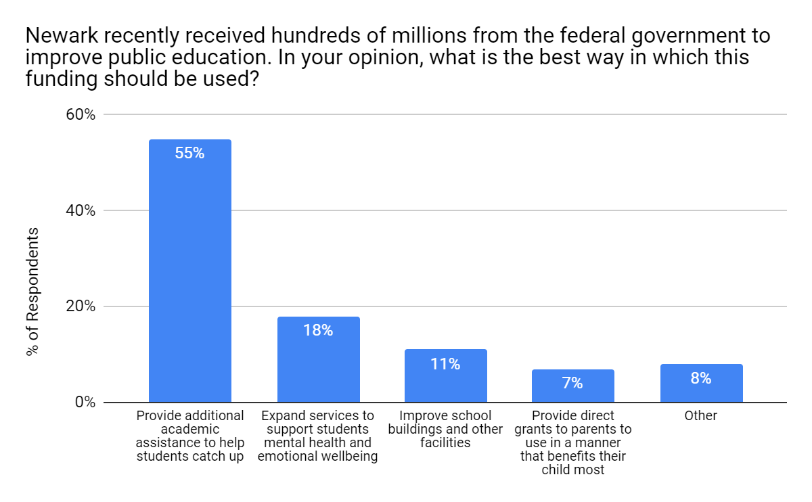
Addressing Learning Loss is Top Priority for Federal Relief $
55% of voters believe that the best way to use federal ARPA funding is to provide direct academic assistance to students to help them catch up, like hiring additional classroom aides, offering after-school tutoring, and expanding summer learning opportunities.

